Slide 1
Homework 2
Due date 2/14 at 11:59 PM

Slide 2
Description
The objective of this assignment is to get you to practice the use of group patterns using swing, java classes and objects as well how button actions work in swing. You will learn how to manipulate groups of objects from associated classes, instantiated objects, and the ability to search directly (looking for a person) or indirectly by starting with address attributes like street addresses.
Your application must implement the functions (use-cases or buttons) in the attached screen shot. For each class you must define at least the attributes outlined in the screenshots.

Slide 3
The Model
Work Address
Person Directory
Person
Address
Home Address
-Use arraylist to implement Person directory
-Searches for persons or addresses happens
In the Person Directory component
Addresses are accessible only through Person

Slide 4
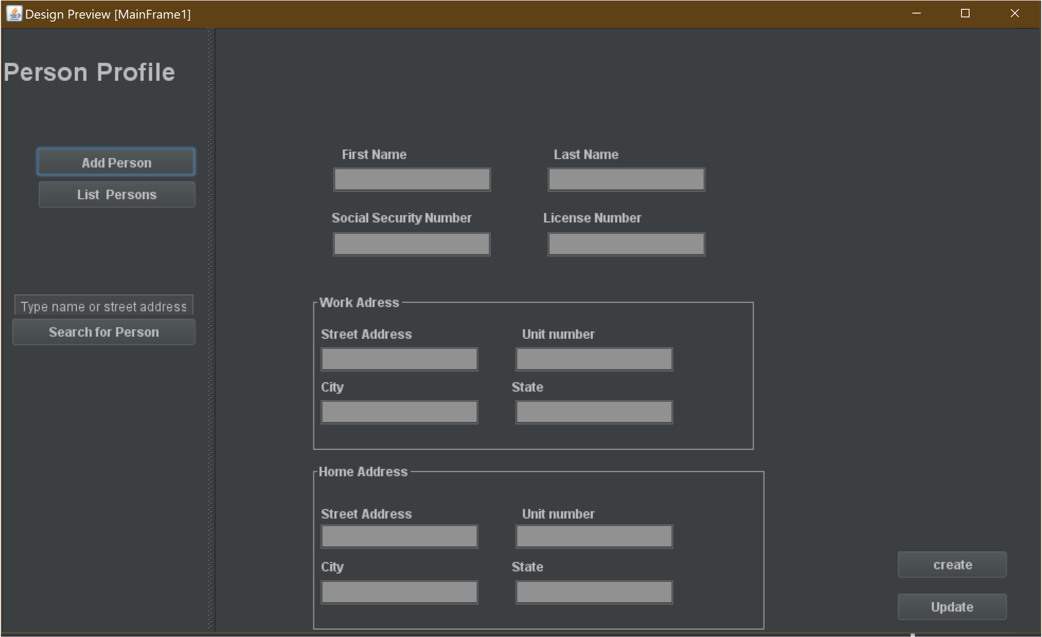

Slide 5
Key Features
Your swing app must have the ability to:
Create a new person with their associated address. Address objects can only be accessed through the person class.
Search for person by their first name, last name, or street address. If a match is found, then display the complete person profile as shown in the screenshot. If no match found, then no action is required.
When a match is found the person is displayed, allow the user to update any attributes that are on display.
During the mainframe start up, create an initial set of person profiles to populate the person directory with person data (5 persons minimum).
List persons allow you to display the list in a table which will include, first name, last name, city and zip code of home address, as well as city and zip code of work address (one person row at the time).

